Slide 1
UROP Project Plant Disease Detection Using Image processing
-By
N.Akhila(AP19110010322)
K.Manasa(AP19110010343)
S.Navya(AP19110010417)
K.N.P.Suparnika(AP19110010480)

Slide 2
Contents
Introduction
Pre-Processing Methods
Classification Models
Results
Conclusion & Future work

Slide 3
Introduction
This project is based on Machine Learning. Using Several Classification Models and Image processing techniques, one can classify the leaf and its disease.
This will help farmers to understand the nature of the crop and help them to increase the crop yield.

Slide 4
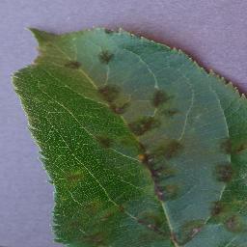
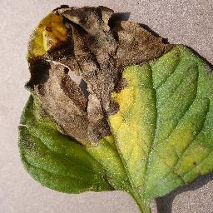
Introduction: Dataset
It is an open source data set.
The data set link is provided by Pranesh Shridhar Kulkarni through Research Gate.
The data set contains leaves of 38 classes, out of which we have taken 25 classes.
Apple_scab
Tomato_Late_Blight

Slide 5
Pre-Processing Methods
Gray Scale Conversion
Otsu’s Thresholding
Morphological transformation
Bit and Operation
GLCM(Gray Level Co-Occurance Matrix)
Standard Scalar Normalization

Slide 6
Classification Models
1.KNN(K-Nearest Neighbor)
The KNN algorithm assumes the similarity between the new case/data and available cases and puts the new case into the category that is most similar to the available categories.
The KNN algorithm can be used for Regression as well as for Classification but mostly it is used for the Classification problems.
2.DECISION TREE:
A decision tree is a flowchart like tree structure. Where each internal node denotes a test on an attribute, each branch represents an outcome of the test, and each leaf node holds a class level. The top most node in the tree is the root node.
The decision tree algorithms can be used for classification problems.

Slide 7
Classification Models
3.SVM(Support Vector Machine)
The goal of the Support Vector Machine algorithm is to create the best line or decision boundary that can segregate n-dimensional space into classes so that we can easily put the new data point in the correct category in the future.
The SVM algorithm can be used for Regression as well as for Classification problems.
4.Random Forest:
Random forest classifier is a type of ensemble algorithm. Builds a set of decision trees from a randomly selected subset of training sets.
The Random Forest algorithm can be used for Regression as well as for Classification problems.

Slide 8
Classifcation Models
5. Logistic Regression
Logistic Regression is a statistical analysis method to predict binary outcome, such as yes, or no based on prior observations of dataset
The Random Forest algorithm can be used for Regression as well as for Classification problems.
6. MLP(Multi-layer perceptron):
A multilayer perceptron is a feedforward artificial neural network that generates a set of outputs from a set of inputs.
The Random Forest algorithm can be used for Regression as well as for Classification problems

Slide 9
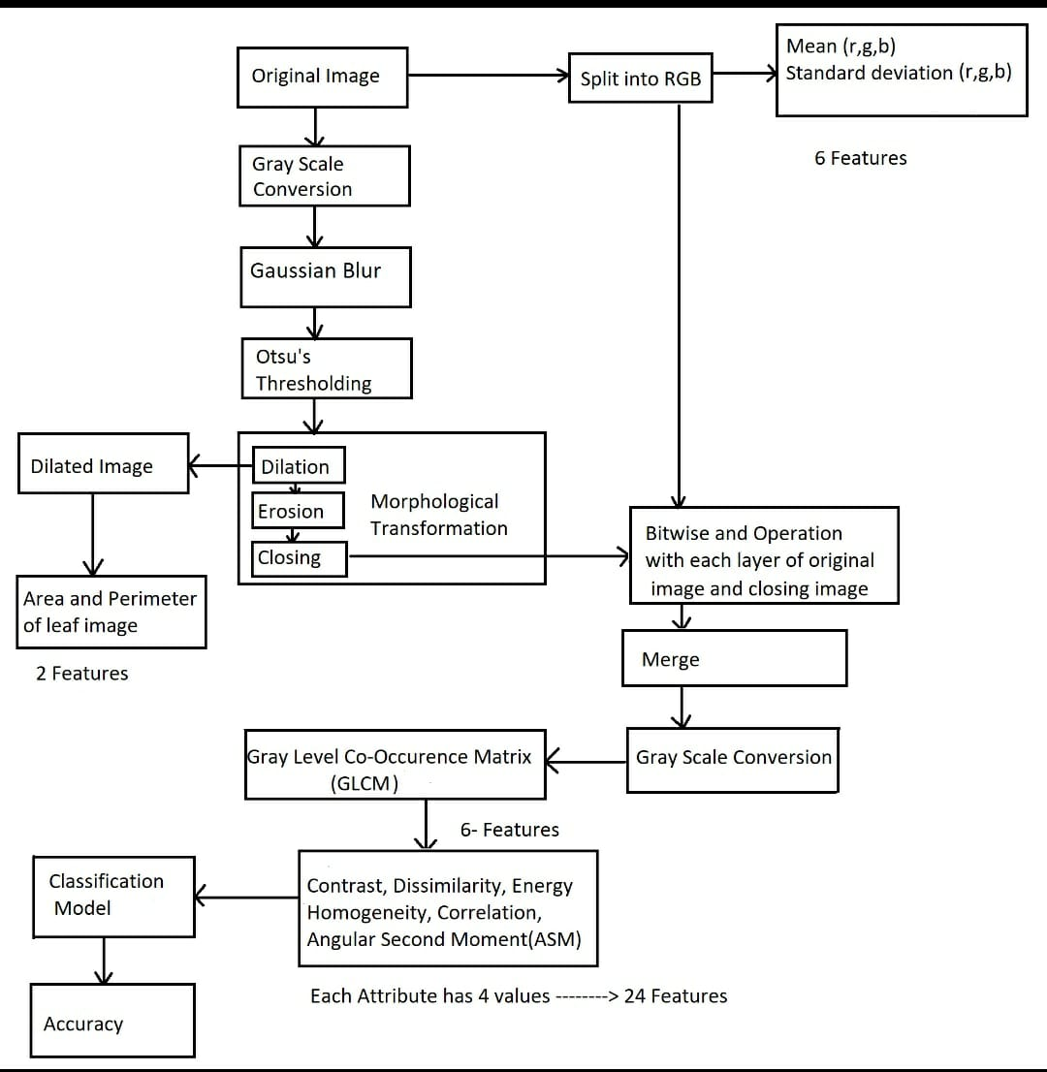
Used methodology: Flow chart

Slide 10
Results
Model | Accuracy | Precision | F1-Score | Recall
SVM | 74.57 | 69.67 | 63.69 | 62.20
KNN | 70.79 | 63.20 | 60.91 | 60.06
Decision Tree | 56.97 | 47.81 | 45.69 | 45.64
Random Forest | 71.92 | 71.08 | 61.79 | 60.07
Logistic Regression | 69.49 | 64.38 | 61.04 | 60.07
MLP | 74.85 | 66.15 | 63.57 | 62.75

Slide 11
Conclusion & Future work
After using several Classification Models, it can be observed that SVM and MLP both have the highest Accuracy. Therefore, SVM and MLP are the recommended methods for this approach.
To increase the accuracy one can use more features without increasing time complexity.
One can also use their own model to predict the output.

